Slide 1

Development and Validation of EEG Markers of Pain Intensity using Machine Learning Algorithms
Mathilda Buschmann, Bachelor of Cognitive Science, Osnabrück
Under the supervision of Michel-Pierre Coll, PhD
Notes:
1

Slide 2




Introduction
Three months internship researching pain in EEG data with help of machine learning (ML) models
Goal: test and compare different ML models to predict pain perception
Pain
Subjective perception
Safeguarding body from harm​
Important measure for success of medical treatment​
Not always communicable
2
Notes:
So far 2 months internship,
Working on pain eeg data,
Testing and comparing ML models to predict pain perception
Pain: subjective perception
Safeguarding body from harm
Important measure for success of medical treatment
Not always communicable: e.g. patient in comatose state
Not able to tell us about their current level of pain
Ml models could help us predicting that from eeg data,
So far for experimental data,
hopefully also clinical data in the future for people that cannot communicate
don’t want to replace subjective perception
Just a first step now to predict experimental pain, not clinical pain
2

Slide 3
Data
5 conditions: ​
5 min rest
8 min thermal,
8 min auditory
8 min thermalrate
8 min auditoryrate
Thermal: different levels of heat induced by thermode
Auditory: unpleasant noise, different levels of volume
Both: scale 0-200
43 participants,
Sex: 17 m, 26 f
Age: 22.6 (± 5.5)
performed at McGILL University, Montreal in 2019
3
Notes:
43 participants,
Sex: 17 m, 26 f
Age: 22.6 (± 5.5)
performed at McGILL University, Montreal in 2019
5 conditions:
5 min rest
8 min thermal,
8 min auditory
8 min thermalrate
8 min auditoryrate
Thermal: main condition
Different levels of heat
Thermal – thermalrate: participant has to rate pain perception or not
Auditory: same distinction
Unpleasant noise
Needed so that model does not learn a general perception, but specifically pain
Both on a rating scale 0 -200
Before experiment, personal pain threshold adjusted bc subjective, temperature of thermode according to personal pain threshold
Thermode arm, 4 positions
Order: rest/heat/audio/heatrate/audiorate
3

Slide 4
Process
Excluding bad channels and spans of data
Removing noise
Choosing models, training in Python
Choose best model(s), train on whole data, test on new data
Preprocessing
Inspection
Training ML
Comparision
Results
Excluding bad channels and participants by hand
Analyzing scores of different models
4
Notes:
4

Slide 5
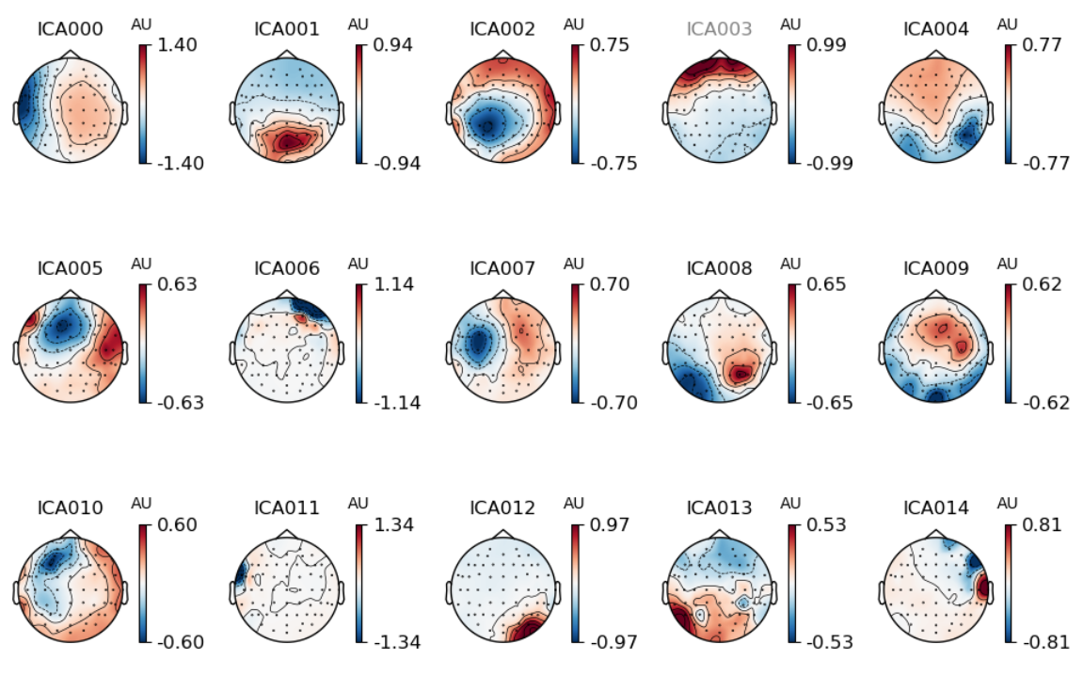
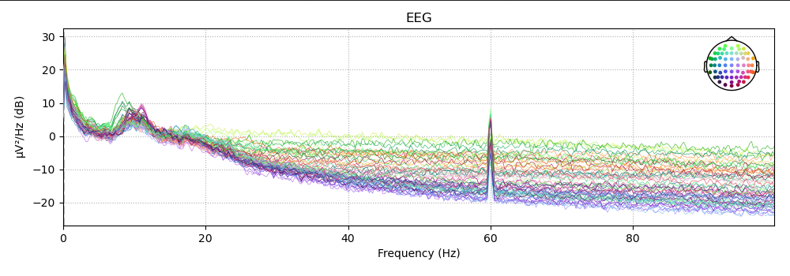
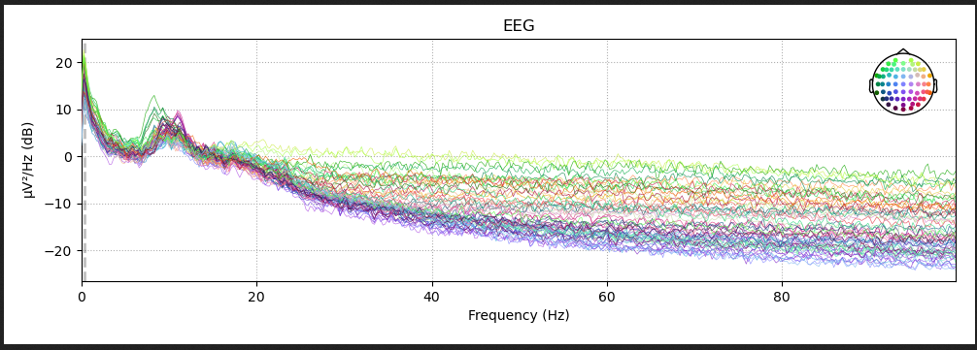
Preprocessing
Identify bad EEG channels
Remove landline noise​
Remove components of the data
Remove bad spans of data
Reject participants
5
Notes:
Identify bad EEG channels
Remove landline noise
Power Spectral Density : different frequencies of the channels and their power, peaks at 60 Hz, that’s landline noise -> removed
Remove components of the data:
ICA: splits data into different components, here a componend from eyeblinks (concentration on the forehead), don’t want this to have an influence on our data -> remove
Remove bad spans of data
Reject participants
Power Spectral Density (PSD): used to analyze the distribution of power across different frequency bands for each EEG channel.
5

Slide 6
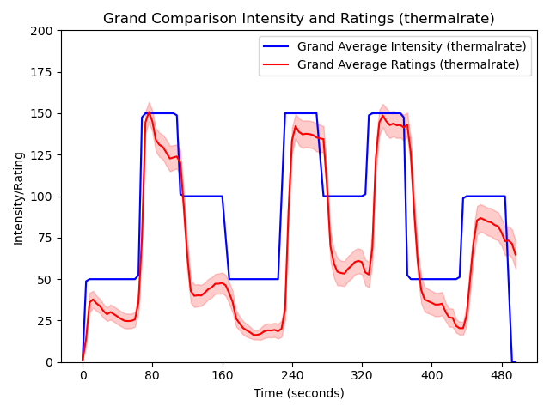
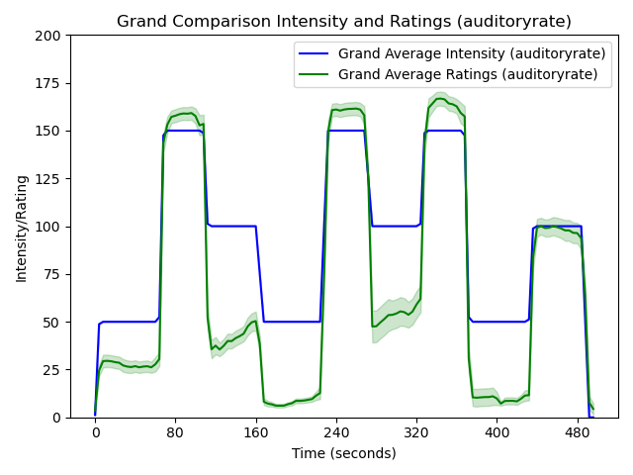
Pain Ratings
Inspection
Auditory Ratings
6
Notes:
- Y : intensities of noise and pain on the scale of 0 – 200,
X: time in seconds
Blue: applied intensity
Red/ green: pain and unpleasantness rating
0 –100 not painful
100: starting to be painful
See that rating generally follows the applied intensity, but is mostly below it
During auditory, peaks are higher
For training of models, 8 mins where split into 4 s windows, predict average
Try to predict intensity for now
standard error (SE) is a measure of the variability or uncertainty of a sample statistic
SEM indicates how much individual data points in the sample tend to deviate from the sample mean. In other words, it represents the spread or dispersion of the data points.
the standard error of the mean (SEM) is often used when calculating the SE of a sample mean. It's calculated as SEM = SD/sqrt(N)
SEM is the standard error of the mean.
SD is the standard deviation of the sample.
N is the number of observations in the sample.
6

Slide 7
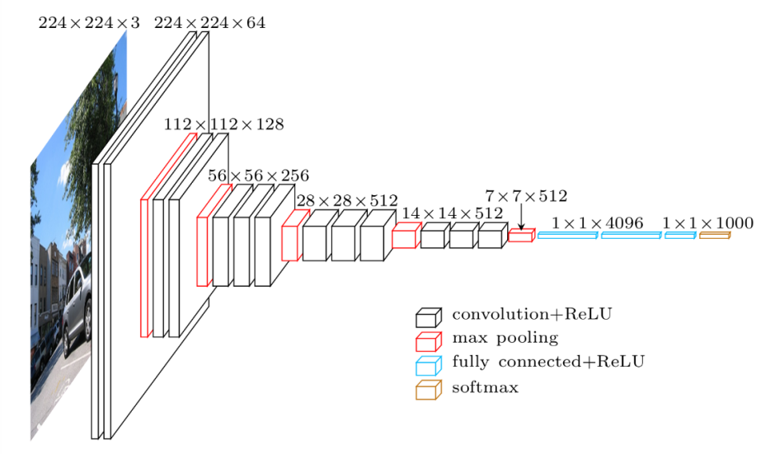
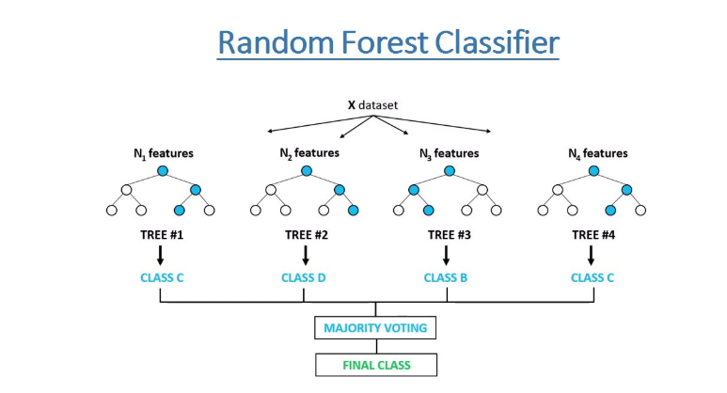
Models
Training ML
Deep Learning (DL)
Standard machine learning (ML)
Deep CNN (Deep4Net)
Shallow CNN (Shallow FBCSP Net)
Random Forest
Common standard ML model in recent studies
Sources: https://www.jeremyjordan.me/convnet-architectures/, https://zindi.africa/learn/random-forest-classifier-tutorial-how-to-use-tree-based-algorithms-for-machine-learning
Notes:
For training, two different kinds of models:
DL: Neural networks,
Implemented Convolutional Neural Networks,
A deep one with more layers and a shallower one with less layers
Standard ML:
Mainly Random forests, because most promising from comparable experiments
Also implemented other models like SVMs, Elastic Net or SGDs
Developped by Schirrmeister et al. 2017
Why random forests: Engemann et al 2022
Filter Bank Common Spatial Patterns Network: 2 layers
Deep4NET: four blocks of convolution-max-pooling
7

Slide 8
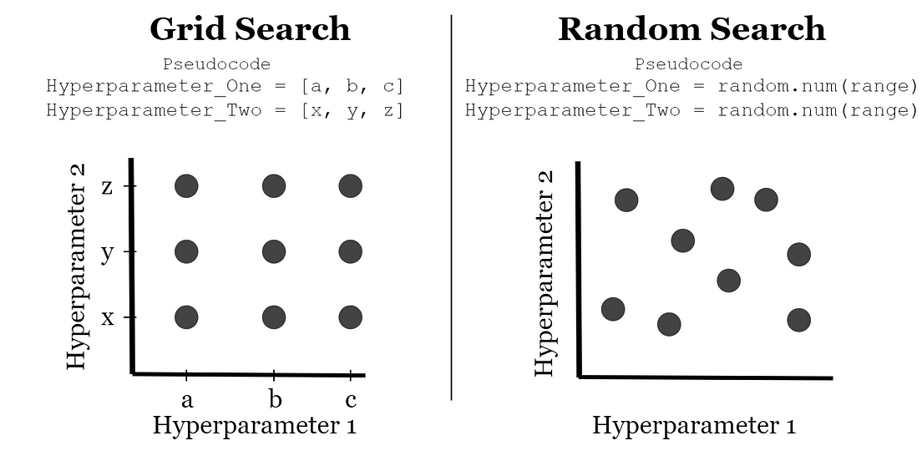
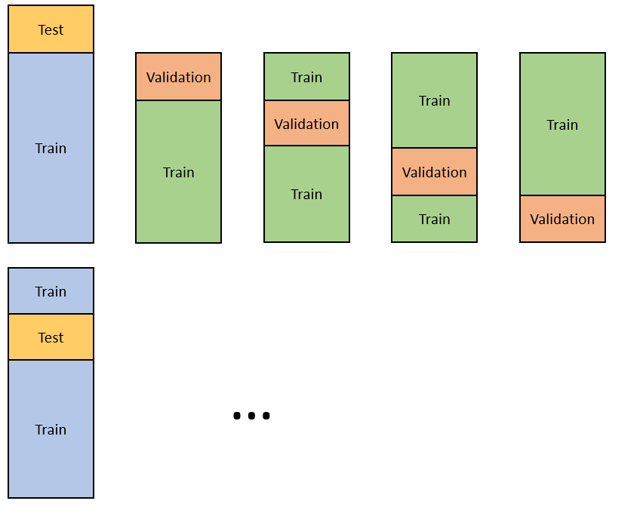
Grid Search and Nested Cross-Validation
Training ML
Goal: get an estimation of a ML model's performance while also optimizing its parameters
Divide data into several folds,
Train on one part, test on other part
Goal: Find best parameters for model​
Here, used for standard ML models
Sources: https://www.analyticsvidhya.com/blog/2021/03/a-step-by-step-guide-to-nested-cross-validation/, https://medium.com/@jackstalfort/hyperparameter-tuning-using-grid-search-and-random-search-f8750a464b35
Notes:
For training ML models: Grid Search and Nested Cross-Validation
You can give your model different values that are better or worse for you task at hand,
Try to find the best combination of these parameters with Grid Search
Go through all combinatons of parameters like in a grid
Then put this into nested cross validation:
Split your data into different parts, train on the bigger part and try to find the best combination of parameters
Test on the missing part
This way, see haw good the model is for new data

Slide 9
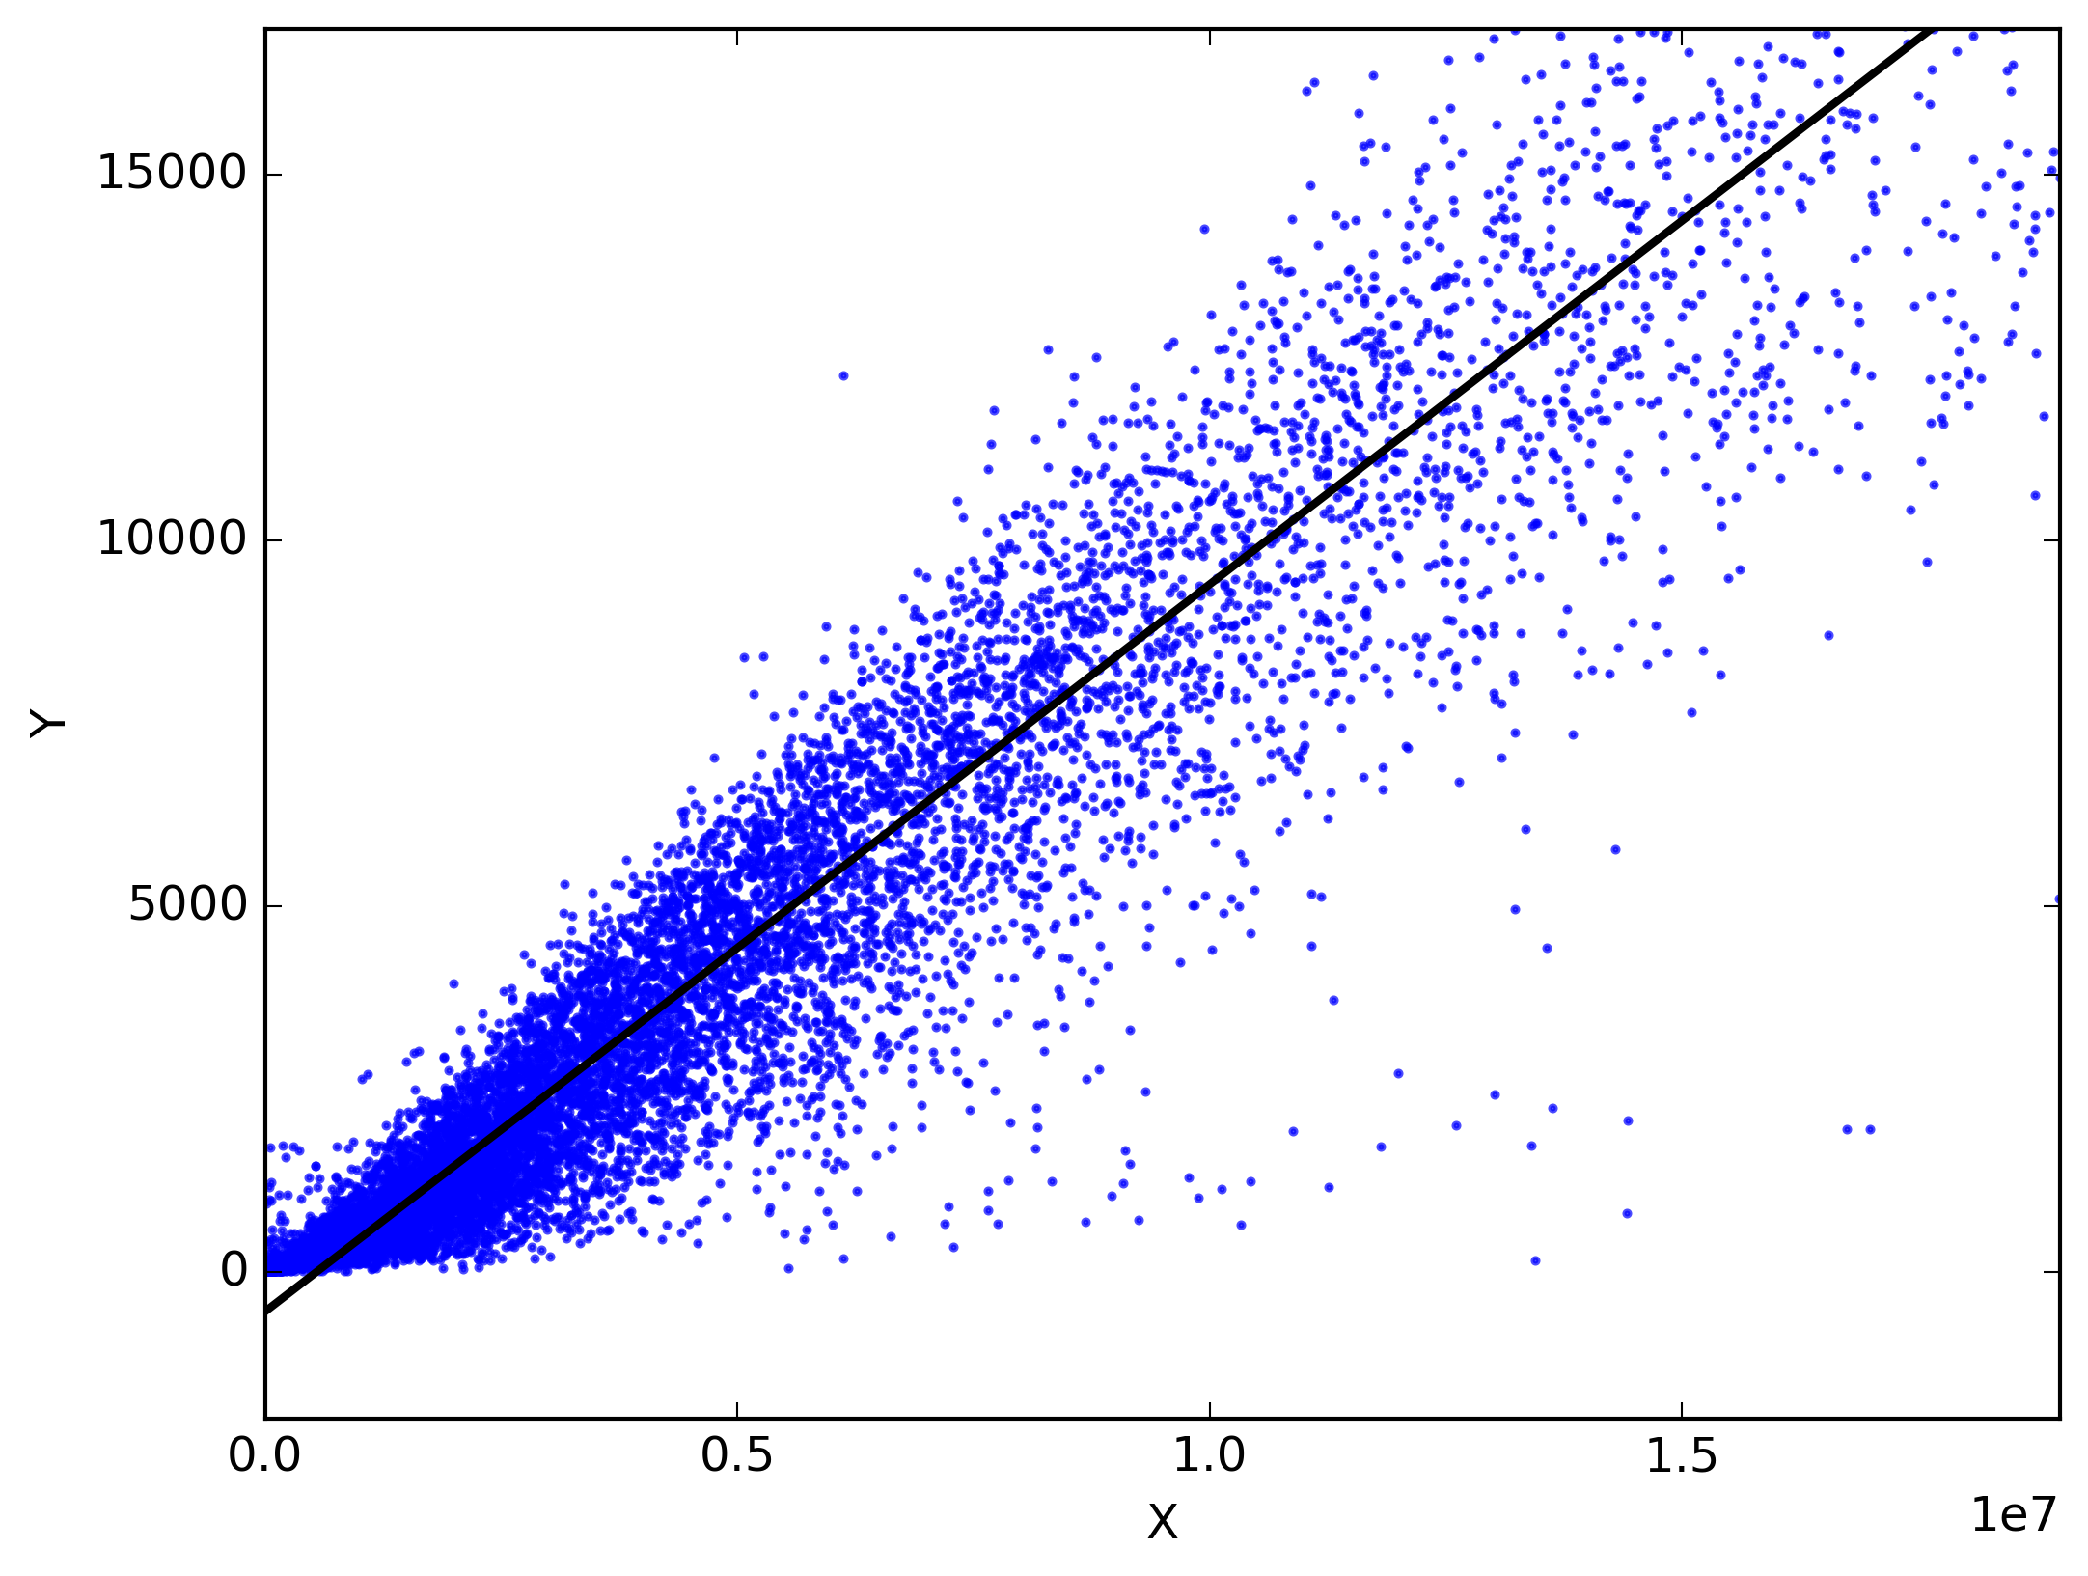
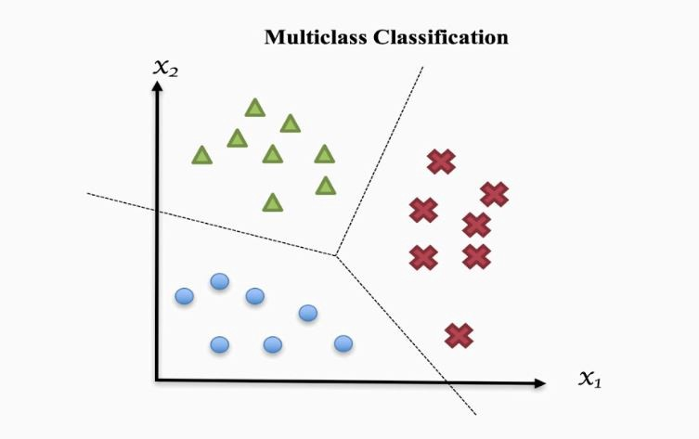
Regression
Training ML
Predicting the value of intensity
Continuous values
Evaluation: root mean square error (RMSE)
Classification​
Predicting the task of the data point
3 distinct classes: rest, auditory, thermal
Evaluation: Accuracy
Pure chance: 33%
9
Sources: https://medium.com/analytics-vidhya/simple-and-multiple-linear-regression-maths-calculating-intercept-coefficients-and-9b05756391b5, https://sv4u.webflow.io/blogs/classification-in-machine-learning
Notes:
Actually two types of predictions possible:
Regression: Predicting the value of intensity
Continuous values
Evaluation: root mean square error (RMSE), minimize
how many units the prediction is off on average
Classification:
Predict the condition this span of data is from
Three classes: rest, auditory, thermal
Evaluation method: Accuracy
Ratio of correct predictions to total predictions
Pure chance: 33%

Slide 10
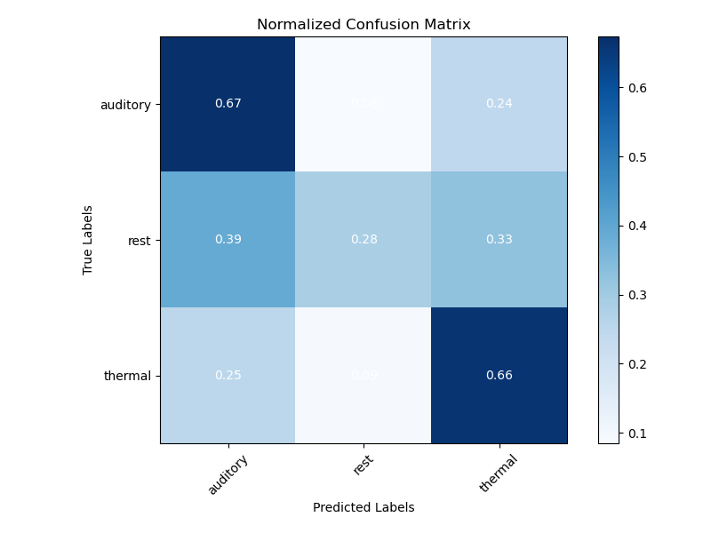
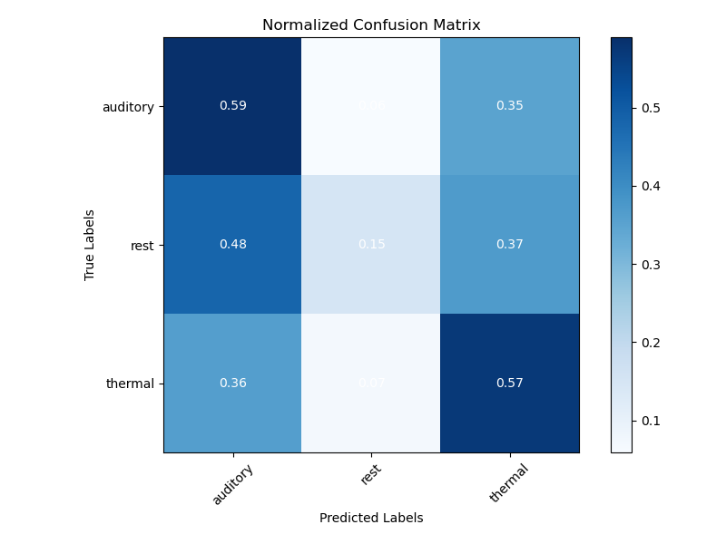
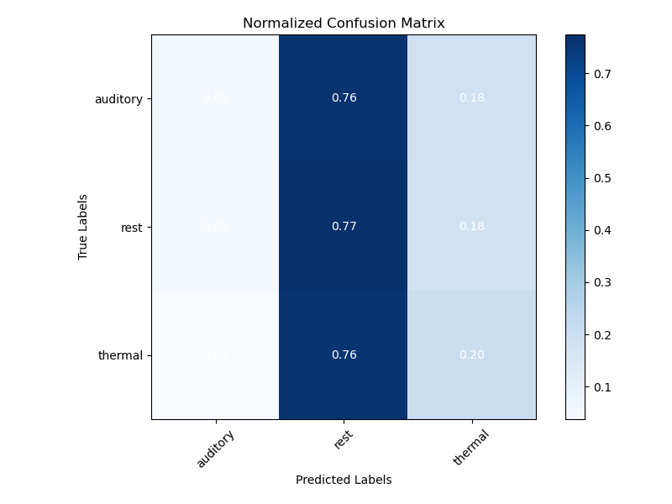
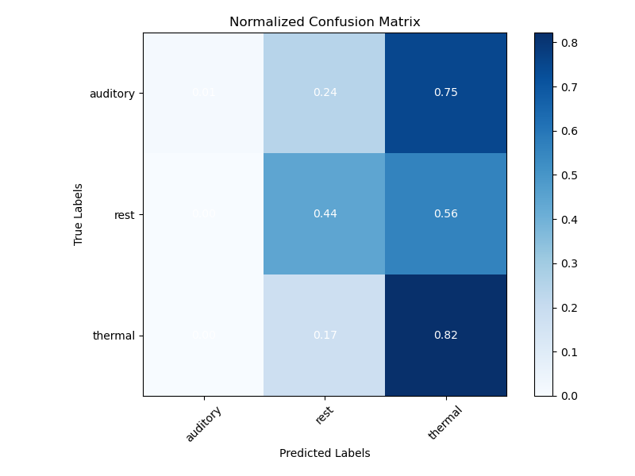
Within vs Between Participants
Training ML
Within Participants
Between Participants
Shallow FBCSP Net
Deep4Net
10
Notes:
Also possible tió make another distinction:
- within – between participants
- within: train on data of one participant, test on data of same participant
Between: train on data of some participants, test on data of different participants, generalization to new patients
Here, some first results for the classification task for the DL models:
Confusion matrices
X: predicted labels
Y: true labels
The darker, the more predictions where made
Idealy, diagonal patches
Here, shallow good for auditory and thermal, not for rest
Better at predicting a perception than just resting
Deeper network: worse, less accurate predictions
10

Slide 11
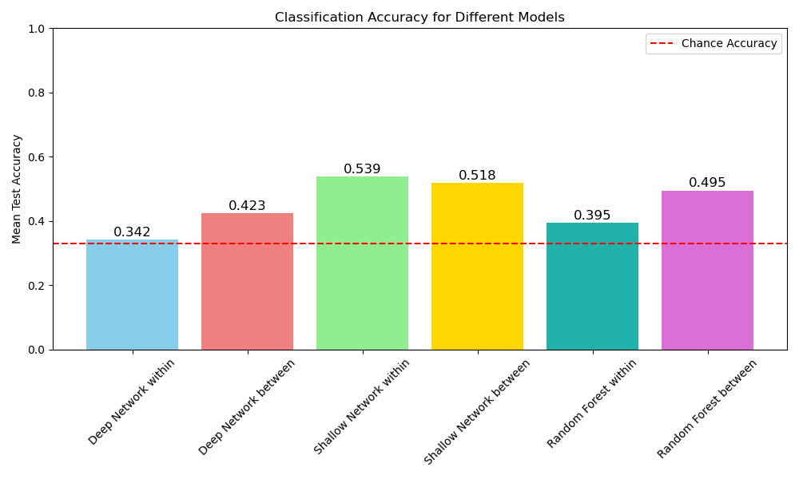
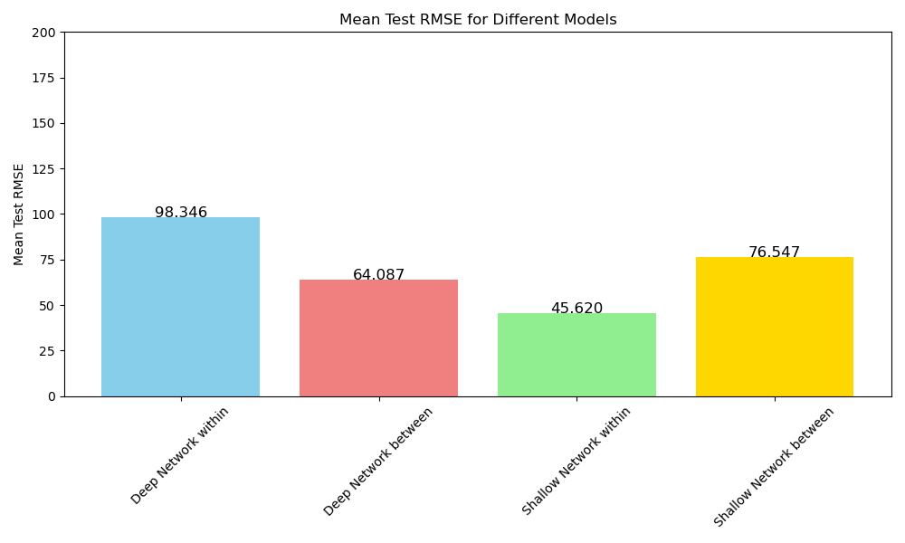
Comparision
Results classification task of different models within and between participants
Results regression task of different models within and between participants
11
Notes:
Results of bestmodels in classification and regression:
Classification shallow DL network best, especially for within participants, 54% correctly predicted
Most models above chance level
Regression: best model over all shallow DL network within participants with an error of 45 units,
Between participants deeper network better
No results for Random Forest regression yet
Reason why shallow slightly better: less overfitting, vanishing gradients
Rmse: how many units the prediction is off on average
11

Slide 12
Results and Outlook
Classification:
Best Model so far: Shallow FBCSP Net
Within participants slightly better (ca. 2%)
Regression:
Best Model so far:
Within participants: Shallow FBCSP Net
Between participants: Deep4Net
OVERALL:
DL better results than standard ML
Within participants easier than between participants
Results above chance level
NEXT:
Finetune models further
Train models on whole dataset
Test on new data​
12
Notes:
This Implies that ML models can predict pain intensity and also conditions,
DL better than standard ML,
So far in an experimental setting
No perfect results, but clearly above chance, and probably still improvable
Easier to predict conditions than pain bc subjective feeling,
For the remaining weeks:
Finetune models further
Train models on whole dataset
Test on new data
12

Slide 13



Thank You
Supervisor : Michel-Pierre Coll, PhD
Presenter: Mathilda Buschmann
Mail: mbuschmann@uni-osnabrueck.de
13
Notes:
Quebec financed data acquisition?
Compute canada?
13

